Slide 1

Introduction to Postman: API Testing Made Easy
A comprehensive guide to mastering API testing with Postman, designed for beginners and teams looking to streamline their testing workflows.
Presented By : Tejas Gamit

Slide 2
What We'll Explore Today
01
02
03
Understanding API Testing
Discovering Postman
Key Features
Learn the fundamentals of API communication and why testing matters
Explore why Postman has become the industry standard for API testing
Uncover powerful capabilities that simplify your testing workflow
04
05
Practical Example
Real-World Benefits
See Postman in action with a real-world demonstration
Understand how Postman transforms API testing for teams

Slide 3
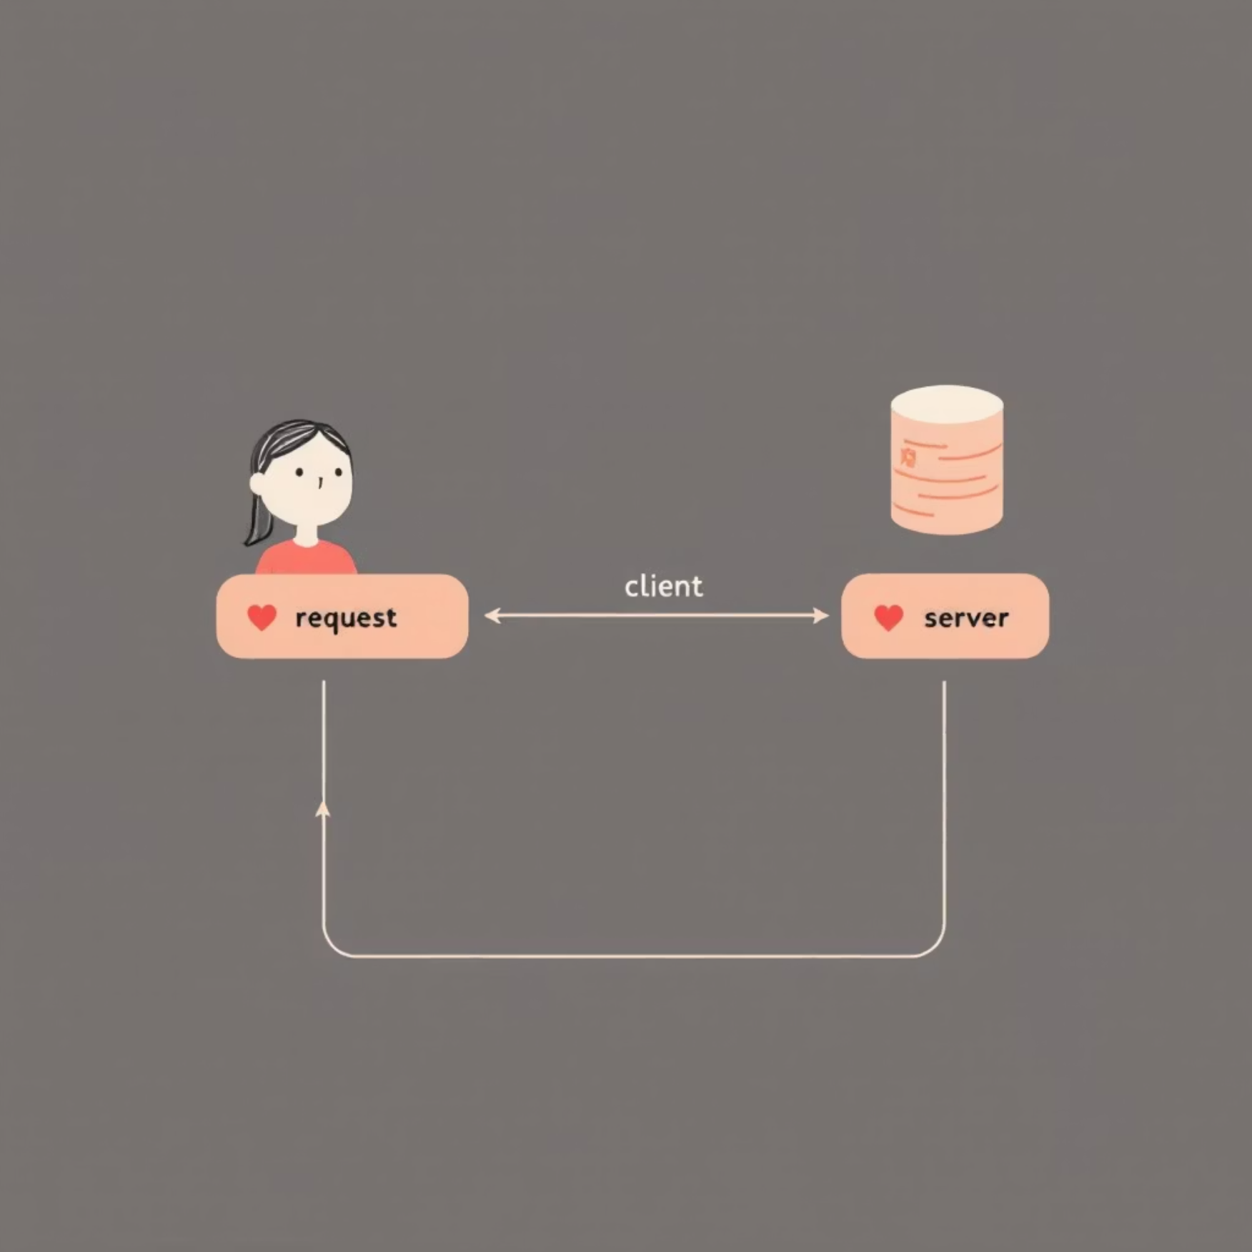



What is API Testing?
API ( Application Programming Interface ) testing validates the communication between different software components. Think of it as checking whether two systems can speak the same language correctly.
When you send a request to a server (asking for data or an action), the server processes it and sends back a response. API testing ensures this conversation works as expected.
Request Sent
Server Processes
Response Received
Client asks for data
Backend handles request
Data returned to client

Slide 4




Why Choose Postman?
Before Postman, testing APIs required writing complex code or using command-line tools. Postman revolutionised this process by providing an intuitive interface that anyone can use.
Test APIs Instantly
Beginner-Friendly Interface
Send requests and see responses in seconds without writing a single line of code
Visual, intuitive design that makes API testing accessible to everyone on your team
Team Collaboration
Share collections, environments, and results seamlessly across your entire organisation

Slide 5
Powerful Features at Your Fingertips
Collections
Environments
Automation
Detailed Reports
Organise related API requests into groups for easy management and reusability across projects
Switch between development, staging, and production environments with a single click
Run entire test suites automatically, saving hours of manual testing time
Generate comprehensive reports showing test results, performance metrics, and trends

Slide 6

How Postman Works
Understanding the testing workflow is key to using Postman effectively. Here's the simple process that happens behind the scenes:
1
Build Request
Configure your API endpoint, method (GET, POST, etc.), headers, and body parameters in Postman's interface
2
Send to Server
Postman transmits your request to the target server, handling all the technical complexity automatically
3
Receive Response
The server processes your request and returns data, status codes, and headers back to Postman
4
Validate Results
Review the response, run automated tests, and verify that everything works as expected

Slide 7

Real-World Example: Testing a Login API
The Scenario
Let's test a user authentication endpoint to ensure login functionality works correctly.
Endpoint: GET / https://catfact.ninja/fact
Purpose: Get Response In Json Format
1
2
3
Select HTTP Method
Enter End Point
Send & Verify The Response
select GET method
Add Public API URL for testing
You'll Get the response in JSON format or Error code : 404

Slide 8

Why Teams Love Postman
Intuitive Learning Curve
New team members can start testing APIs within minutes, not days. The visual interface eliminates the need for extensive training or technical expertise.
Free to Start
Postman offers a robust free tier with all essential features, making it accessible for individuals, startups, and large enterprises alike.
Industry Standard
Over 20 million developers worldwide trust Postman, ensuring excellent community support, tutorials, and integrations with popular tools.
Automation Ready
Scale from manual testing to fully automated CI/CD pipelines without changing tools or workflows.

Slide 9

Where Teams Use Postman
Postman adapts to various workflows and team structures, making it invaluable across the development lifecycle.
Manual API Testing
CI/CD Integration
QA engineers validate endpoints during development and regression testing cycles
DevOps teams integrate Postman tests into automated deployment pipelines
Automated test runs
Functional testing
Build verification
Data validation
Production monitoring
Error handling checks
Team Collaboration
Developers, testers, and stakeholders share API documentation and test results
Shared workspaces
Version control
Real-time updates

Slide 10

Your Journey Starts Here
Why Postman is Essential
Postman transforms API testing from a complex, code-heavy process into an accessible, visual experience. Whether you're a beginner or an experienced tester, it streamlines your workflow and enhances team collaboration.
Ready to begin? Download Postman today and start testing APIs in minutes. Join millions of developers who've already simplified their testing process.
20M+
500M+
100%
Global Users
API Requests
Free to Start
Developers worldwide
Sent daily via Postman
No credit card required
Thank You
We appreciate you taking the time to learn about Postman today. Please feel free to reach out if you have any questions about enhancing your API development workflow.

